Slide 1
Decision Making
Discuss how people respond to different fire cues based on the individual and the environment
Explain what pre-evacuation time is and why it is important

Slide 2
Historic Fire
King’s Cross Station

Slide 3
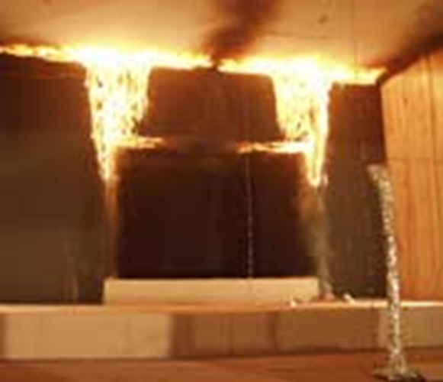
Response to Cues
Direct observation
  See flames
  Smell smoke
Indirect cues
  Fire alarm
  Observe firefighters
  Word of mouth

Slide 4
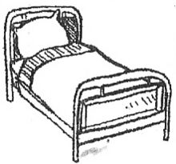
Awareness Issues
Perceptual difficulties
Sleep
Alcohol
Drugs

Slide 5
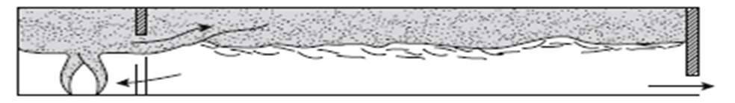
Use of Built Environment
Component widths
Geometry
  Turns
  Treads
  Handrails
Time
Location
Integrity of route

Slide 6
Notification
Not all people receive message
  Background noise/images
  Hard of hearing
  Limited vision
  Dedicated to task
Not all people comprehend message
  Recognition of alarm
  Do not speak/read language

Slide 7
Response
Actions
  Waking up
  Gathering more information
  Dedicated to task
  Notifying others
  Preparing
  Fighting fire

Slide 8
Pre-Evacuation Time
Amount of time can be great
Introduces uncertainty
  Densities
  Exposures
Messaging is critical
  Attention
  Source
  Event
  Location
  Action
  Time

Slide 9
Expected Times
There is no single number
There are no general engineering guidelines
  No rules of thumb
  No table values
Need to use engineering judgment
  Informed

Slide 10
Decision Making in Models
Reality based on actions
Rule based
  Set times
  Level of knowledge
  Changes in decisions

